Slide 1
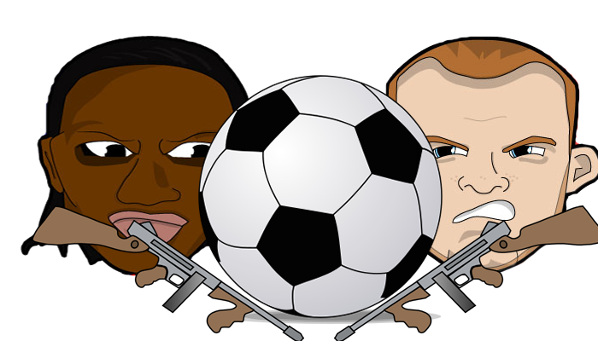

By: Aaron Fitzgerald and Azeez Yusuff

Slide 2
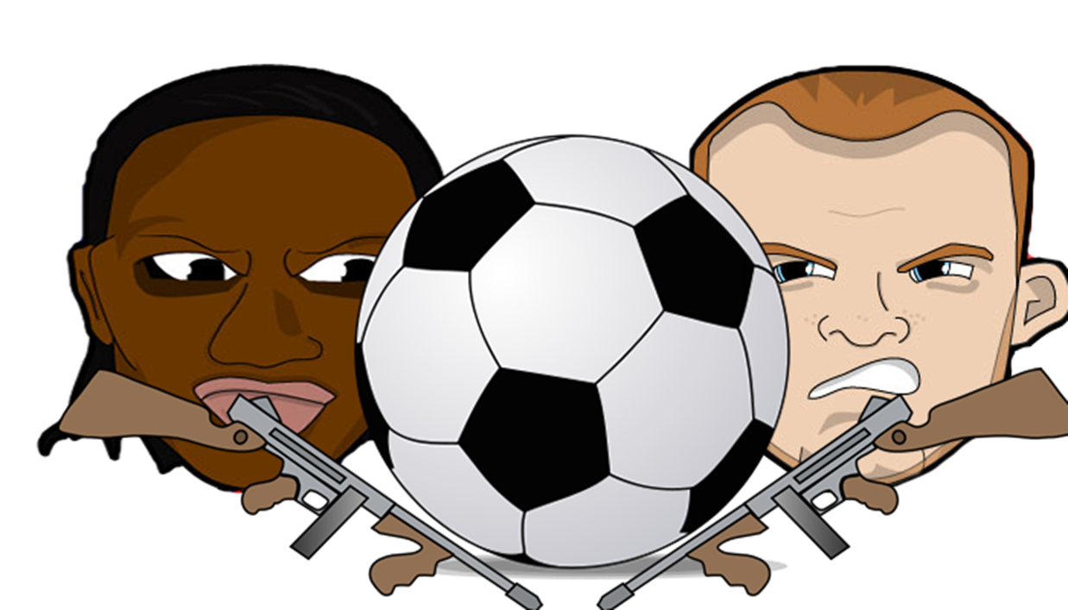

Who we are…
Website for football lovers and anybody
looking for something funny and different
Provide animated videos and comics,
usually with a funny twist
Keep you up to date with the BPL table

Slide 3
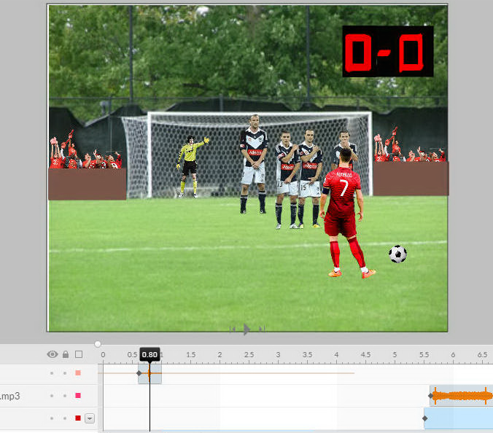
How we animate…
Animatron
Used for nearly all of our videos
Fun, easy to use and mobile friendly

Slide 4



Fireworks
Used to edit our logo, name and images used in our banner!
And our social media images

Slide 5
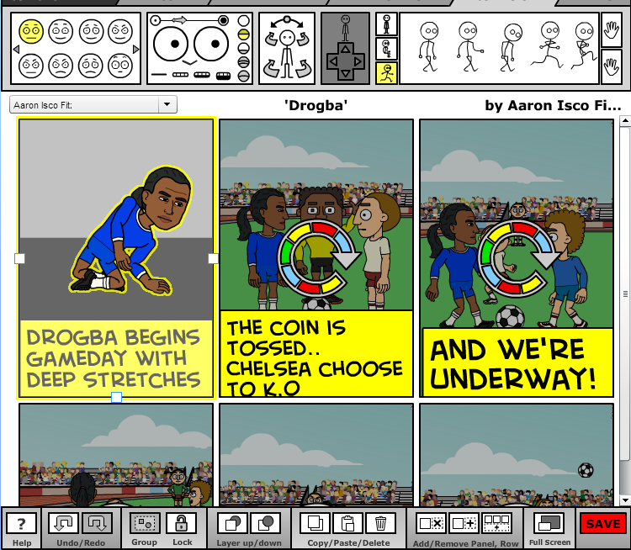
Bitstrips
Bitstrips is a powerful comic maker
that let’s you control every last detail
of what you are making

Slide 6
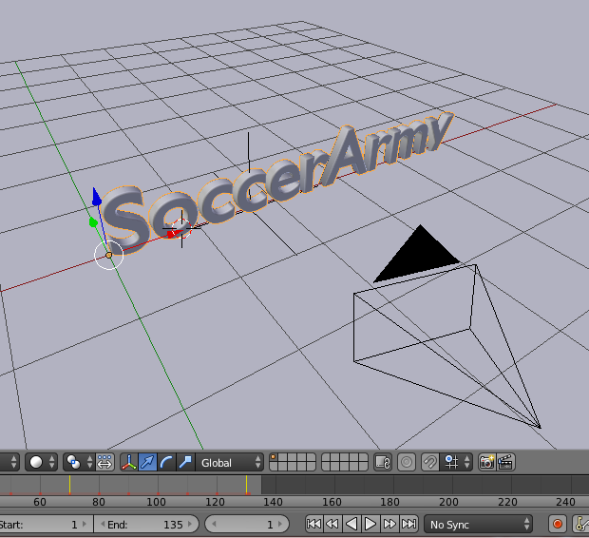
Blender
Used a small bit to make a dissolving
animation

Slide 7
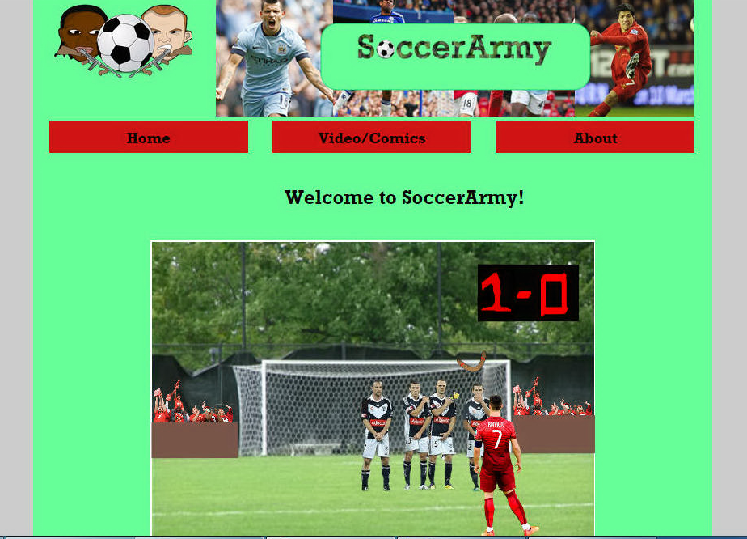
We hope you enjoy our site
Thank you!

